Slide 1

MYSQL project
HOSPITAL MANAGEMENT ANALYSIS
- Sangeetha s

Slide 2
OBJECTIVES
The primary objective of hospital management analysis is to optimize the efficiency and effectiveness of healthcare delivery within a hospital or healthcare system.
This involves assessing various aspects such as resource allocation, patient flow, quality of care, and financial performance to enhance patient outcomes while managing costs and resources effectively.

Slide 3
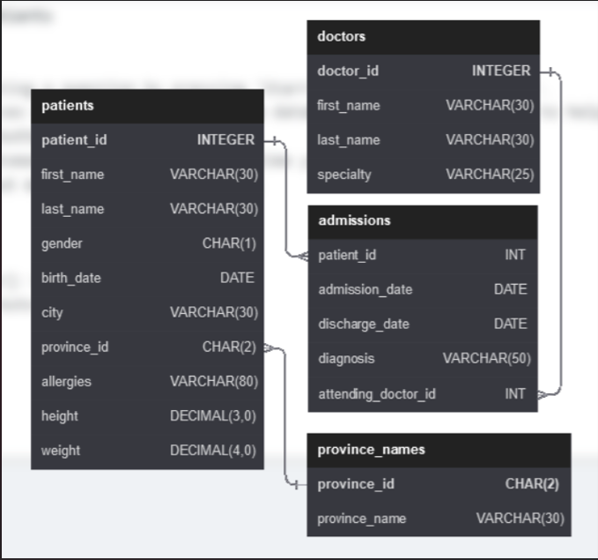
HOSPITAL MANAGEMENT DATABASE SCHEMA

Slide 4

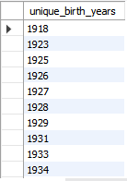
QUESTION – 1 Show unique birth years from patients and order tham by ascending

Slide 5

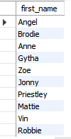
QUESTION – 2 show unique first names from the patients table which only occurs once in the list.for example, if two or more people are named "john" in the first name column than don't include their name in the output list. if only 1 person is names "lee" then include them in the output

Slide 6

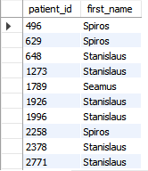
QUESTION – 3 show patient_id and first_name from patients where their first_name start and ends with "s" and is at least 6 characters long

Slide 7


QUESTION – 4 show the total amount of male patients and the total amount of female patients table. display the two results in the same row.

Slide 8
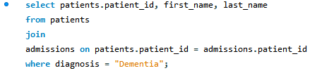
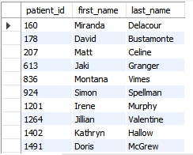
QUESTION – 5 show patient_id, first_name, last_name from patients whose diagnosis is ' dementia'

Slide 9
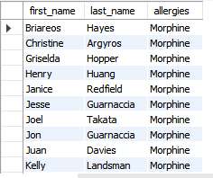

QUESTION – 6 show first and last name, allergies from patients which have allergies to either 'penicillion' or 'morphine'-- show results ordered ascending by alleries then by first_name then by last_name

Slide 10

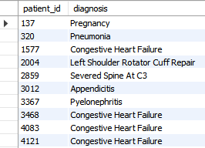
QUESTION – 7 show patient_id, diagnosis from admissions. find patients admitted multiple times for the same diagnosis

Slide 11

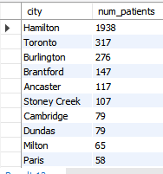
QUESTION – 8 show the city and the total number of patients in the city . order from most to least patients and then by city name ascending

Slide 12
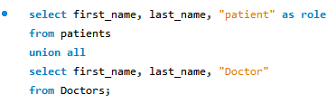
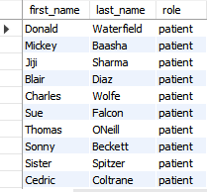
QUESTION – 9 show first name, last name and role of every person that is either patient or doctor. the roles are either " patient", "doctor"

Slide 13
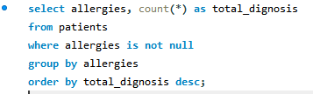
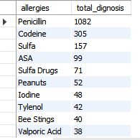
QUESTION – 10 show all allergies ordered by popularity. remove null values from query

Slide 14

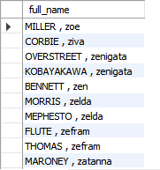
QUESTION – 11 we want to display each patients full name in a single column. their last name in all upper letters must appear first name in all lower case letters. separate the last name and first name with a comma. order the list by the first name in decending order.

Slide 15


QUESTION – 12 show the province_id, sum of height , where the total sum of its patients height is greater than or equal to 7000

Slide 16


QUESTION – 13 show the difference between the largest weight and smallest weight for patients with the last name ' marani'

Slide 17
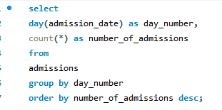
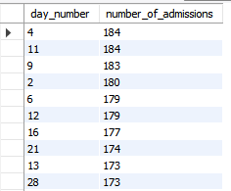
QUESTION – 14 show all of the days of the month and how many admission_dates accured on that day. sort by the day with most admissions to least admissions

Slide 18
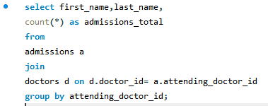
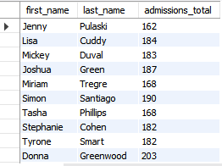
QUESTION – 15 show first name, last name and the total number of admissions attended for each doctor.-- every admission has been attended by a doctor.

Slide 19
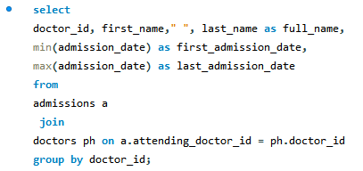
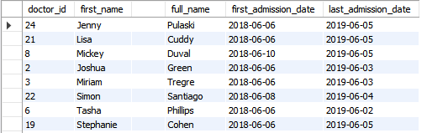
QUESTION – 16 for each doctor, display their id, full name, and the first and last admissions date they attened

Slide 20
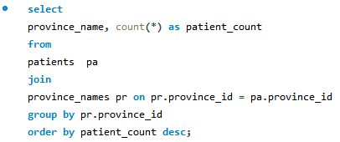
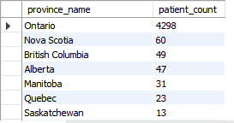
QUESTION – 17 display the total amount of patients for each province. order by descending.

Slide 21
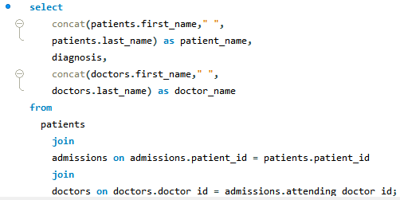
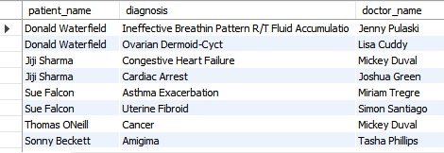
QUESTION – 18 for every admission, display the patients full name, their admission diagnosis, and their doctors full name-- who diagnosed their problem.

Slide 22
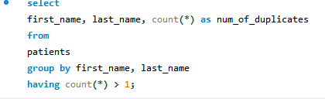
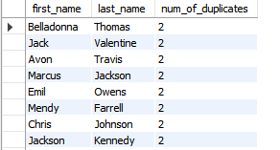
QUESTION – 19 display the first name, last name and number of duplicate patients based on their first name and lat name

Slide 23
THANK YOU

